Slide 1

Robust Protection Plug-in For Sensitive Cloud Storage Data
SANTHOSH .M - 8208E21BSR050
KARTHIKEYAN .N - 8208E21BSR028
MD HASHIF .H - 8208E21BSR034
Under the guidance of
DR. P. ANANDRAJ
Assistant professor & HOD
Department of Computer Science And Business System
E.G.S. Pillay Engineering College (Autonomous)
Nagapattinam, Tamilnadu.

Slide 2
Presentation Flow
Problem statement
Literature Review
Feasibility of the proposed project work
Identification of objectives
Methodology of the Proposed Work

Slide 3
Problem Statement
Lack of Secure Cloud Storage: Users face risks of data breaches in cloud storage platforms, leaving sensitive files vulnerable to unauthorized access.
Manual File Encryption Complexity: Existing tools require technical expertise to encrypt files before uploading, making the process cumbersome for non-technical users.
File Integrity and Accessibility Issues: Ensuring file integrity during upload/download and secure access without compromising usability is a significant challenge.

Slide 4
Problem Statement
Unauthorized Access: Sensitive data can be accessed by unauthorized users, including malicious insiders.
Data Breaches: Leaked or stolen data might be exploited by attackers if not encrypted.
Data Tampering: Sensitive data could be modified by malicious entities in the cloud.

Slide 5
LITERATURE REVIEW
This paper explores the use of attribute-based encryption to ensure privacy-preserving access control in cloud storage systems. It addresses the challenges of balancing security and usability in cloud environments
Journals details | Key points
Title Author Year of Publication | Searchable Public-Key Encryption With Cryptographic Reverse Firewalls for Cloud Storage Yuyang Zhou , Zhebin Hu 2023

Slide 6
LITERATURE REVIEW
This study presents a Client Side Encryption in cloud networks, optimizing the balance between data security. It identifies and tackles current challenges in encrypted data .
Journals details | Key points
Title Author Year of Publication | A Novel Approach for Client Side Encryption in Cloud Computing Md. Mahidul Islam, Md. Zahid Hasan 2019

Slide 7
LITERATURE REVIEW
This Study examines of data and storage security in cloud computing, access control and attribute based encryption. It highlights privacy benefits while addressing challenges of computational efficiency and implementation.
Journals details | Key points
Title Author Year of Publication | Survey of data and storage security in cloud computing S.Rajeswari, R.Kalaiselvi 2017

Slide 8
FEASIBILITY OF PROPOSED PROJECT
Technical Feasibility: The project is viable given the use of established tools like SharpShell, .NET encryption libraries, and Google Drive/OneDrive APIs, ensuring compatibility with personal computers.
Economic Feasibility: The development process is cost-effective, relying on free or low-cost resources such as development environments and cloud services, with minimal hardware or infrastructure costs.

Slide 9
FEASIBILITY OF PROPOSED PROJECT
Resource Feasibility: Required skills and tools (e.g., Visual Studio, C#, Extensions, cloud API knowledge) are readily accessible, ensuring smooth implementation with existing developer expertise..
Risk Feasibility: The project presents manageable risks, such as API changes or security vulnerabilities, which can be mitigated by regular updates and strong encryption practices.

Slide 10
IDENTIFICATION OF OBJECTIVES
Data Security: Provide robust AES-256 encryption to safeguard user files stored in cloud services against unauthorized access and breaches.
Ease of Use: Develop a user-friendly browser extension with drag-and-drop functionality for seamless file encryption and decryption
Cloud Integration: Enable compatibility with multiple cloud storage platforms like Google Drive and OneDrive for automatic uploads and downloads.

Slide 11
METHODOLOGY PROPOSED
Requirements Analysis: Identifying user needs, cloud provider API and encryption protocols.
2. Design & Development: Using SharpShell for Windows Explorer integration or Browser Extension.
3. Cloud API Integration: Implementing APIs to manage file uploads and downloads, ensuring seamless data transfer.
4. Testing & Maintenance: Performing functional and security tests to ensure encryption integrity, cloud compatibility

Slide 12
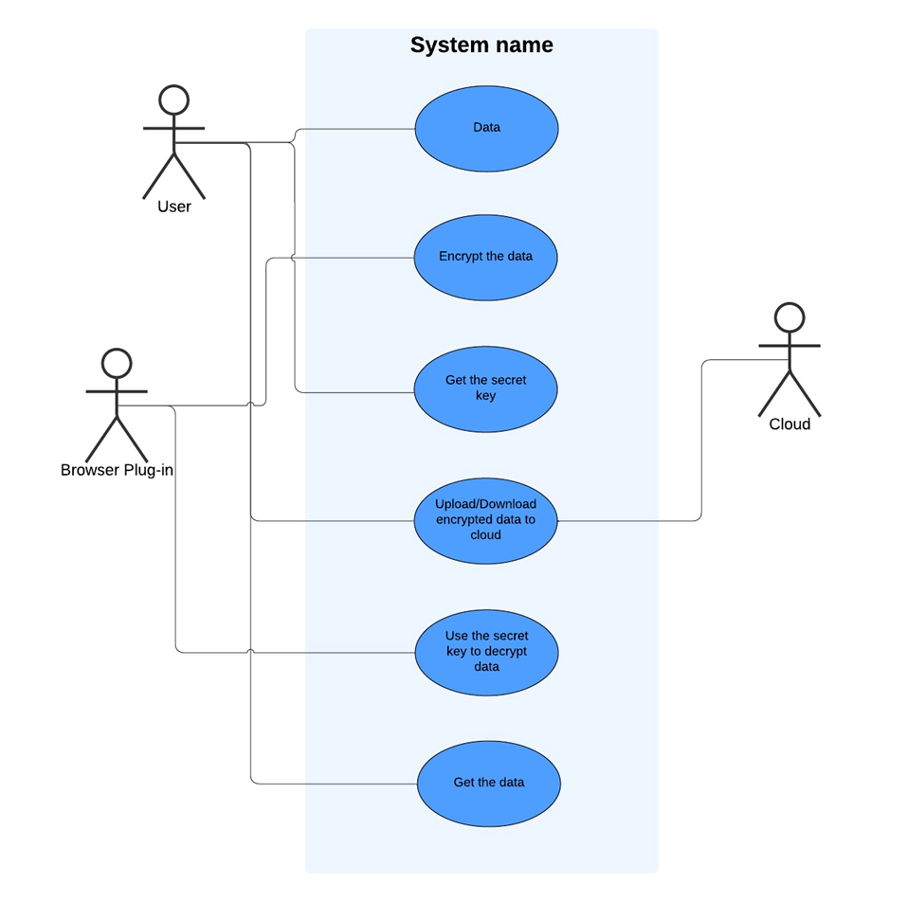
USE CASE DIAGRAM

Slide 13
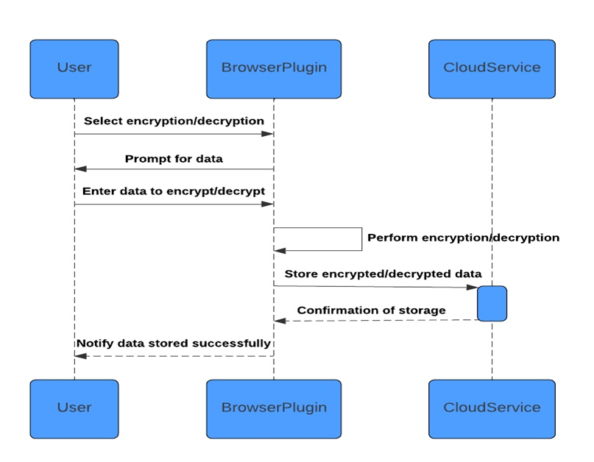
SEQUENCE DIAGRAM

Slide 14
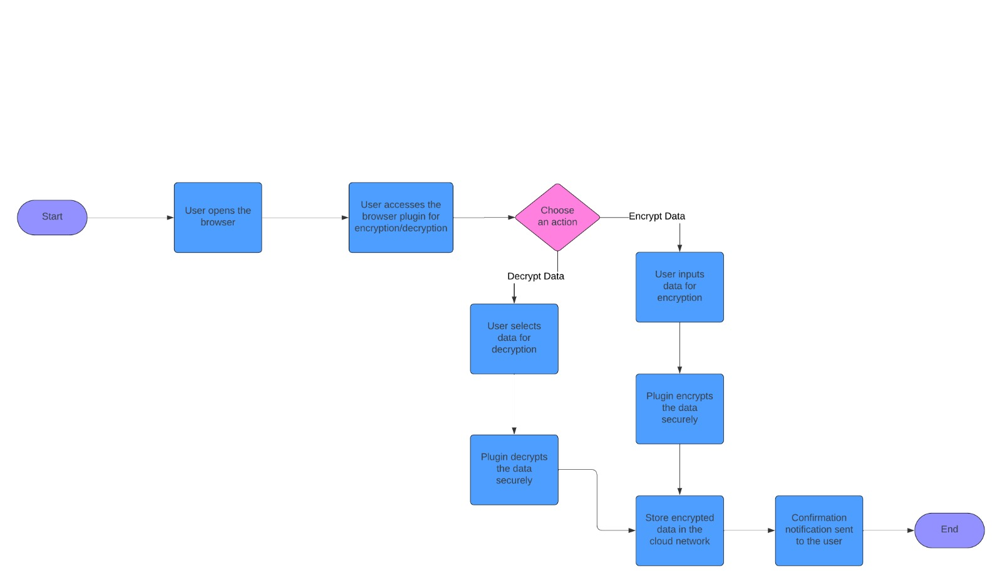
ACTIVITY DIAGRAM

Slide 15
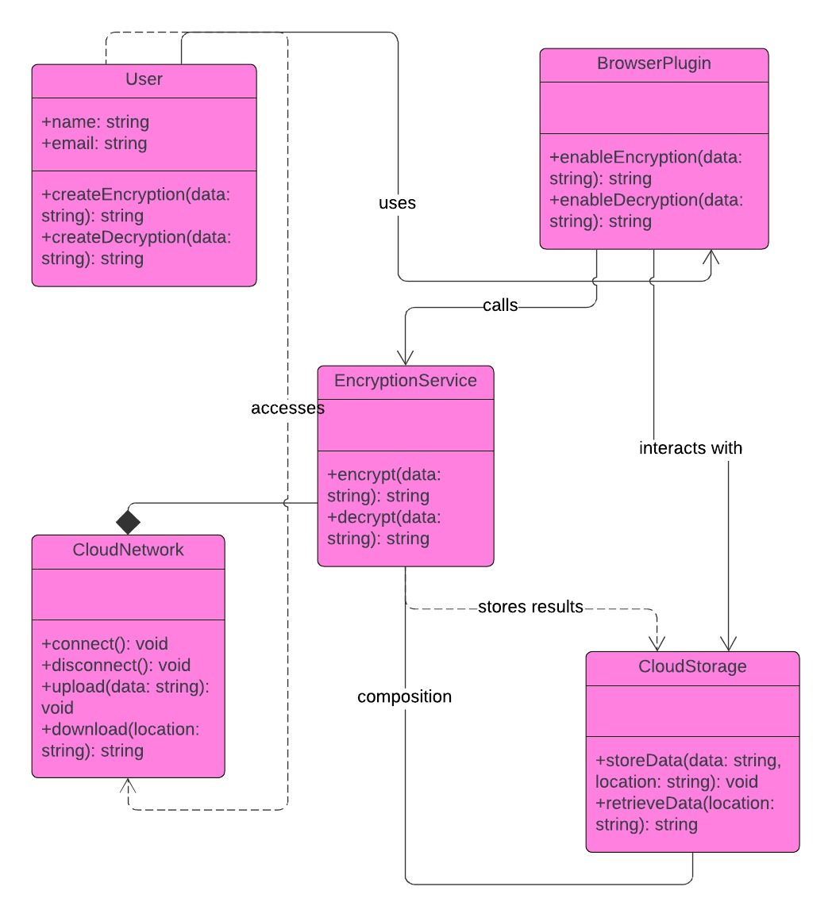
CLASS DIAGRAM

Slide 16
THANK YOU

